Slide 1

KOLHAPUR INSTITUTE OF TECHNOLOGY’S
COLLEGE OF ENGINEERING KOLHAPUR
(EMPOWERED AUTONOMOUS)
Department of Mechanical
Project Title
Smart Shop-Floor Monitoring and Efficiency Tracking System
Guide:
Prof.S.S.Patil
Project Group No: MP07
Name of Projectees
1) SALOKHE ANIRUDDHA PRADEEP 2) DESAI SHRYEAS NILESH
3) GARUD ASHUTOSH MILIND 4) KASHID RICHALI RAHUL
5) DULHANI DHEERAJ RAKESH

Slide 2

Smart Shop-Floor Monitoring and Efficiency Tracking System
The title “Smart Shop-Floor Monitoring and Efficiency Tracking System” is apt because:
It directly addresses limitations of manual data entry in machine shops
Ensures real-time tracking of operator attendance, cycle time, and job counts
Reduces errors and improves transparency in productivity monitoring
Provides actionable insights for better decision-making
Introduces digital automation, making the system efficient and impactful
DEPARTMENT OF MECHANICAL ENGINEERING

Slide 3
Problem Statement
In small & medium machine shops, production details are tracked manually.
Supervisors record: worker in/out time, cycle time, job counts, downtime.
This method is:
Time-consuming
Error-prone
Lacks real-time visibility
No proper logging of:
Machine breakdowns
Tool life usage
Operator efficiency
Conclusion : There is a strong need for an operator-friendly digital solution that automates data collection and provides actionable insights.
DEPARTMENT OF MECHANICAL ENGINEERING

Slide 4
Literature Survey
No. | Title | Authors | Publication Details | Key Findings
1 | Effects of Feedback in Manufacturing: A Field Experiment Using Smartwatch Technology | Daniel Kwasnitschka, Henrik Franke, Torbjørn H. Netland | Journal of Operations Management, 70(6), April 2024 (CiteDrive, sciprofiles.com) | Positively framed, individual-targeted real-time feedback via smartwatches significantly improves productivity in batch manufacturing environments. (CiteDrive)
2 | Worker-Machine Relationship-Based Strategy for Sustainable Management in A Machine Shop | Shiela Mhay R. Dalisay; Arnie Lyn D. Alagos; Charmine Sheena Ramirez Saflor; Klint Allen Mariñas | International Conference on Industrial and Systems Engineering, Technology, Innovation, and Management — Bandung, Indonesia, April 2022 (ResearchGate) | Introduces a strategy focused on enhancing worker-machine relationships to support sustainable management in resource-intensive machine shop environments. (ResearchGate)
3 | Intelligent Scheduling Methods for Optimisation of Job Shop Scheduling Problems in the Manufacturing Sector: A Systematic Review | (Authors not fetched from open page) | Electronics, Vol. 14(8), MDPI, 2023 (MDPI) | A systematic review summarizing AI-driven and intelligent scheduling methodologies to solve complex job shop scheduling in manufacturing.
4 | Movement Analytics: Current Status, Application to Manufacturing, and Future Prospects from an AI Perspective | Peter Baumgartner; Daniel Smith; Mashud Rana; Reena Kapoor; Elena Tartaglia; Andreas Schutt; Ashfaqur Rahman; John Taylor; Simon Dunstall | arXiv preprint (cs.AI), submitted 4 Oct 2022 (arXiv) | Explores how IoT and tracking technologies facilitate movement analytics (e.g., tracking workers, trolleys) in manufacturing and discusses AI-based future directions. (arXiv)
5 | Time-Series Pattern Recognition in Smart Manufacturing Systems: A Literature Review and Ontology | Mojtaba A. Farahani; M. R. McCormick; Robert Gianinny; Frank Hudacheck; Ramy Harik; Zhichao Liu; Thorsten Wuest | arXiv preprint (cs.ML), submitted Jan 29 2023, revised Mar 6 2023 (arXiv) | Provides a literature review and ontology of time-series pattern recognition techniques for Industry 4.0 smart manufacturing systems. (arXiv)
6 | A Data-Oriented Shopfloor Management in the Production Context: A Systematic Literature Review | Patrick Eichenseer, Herwig Winkler | International Journal of Advanced Manufacturing Technology, Vol. 134, pp. 4071–4097, 17 Sep 2024 (SpringerLink) | Reviews the evolution of data-oriented and digital shopfloor management approaches under Industry 4.0, highlighting the increasing role of data technologies. (SpringerLink)
DEPARTMENT OF MECHANICAL ENGINEERING

Slide 5
Literature Survey
Existing software/tools: Tulip, UpKeep, Prodsmart, MaintainX
Provide digital shop-floor solutions.
But Designed for large enterprises, costly, less suitable for SMEs
Research papers highlight importance of:
Real-time operator & machine data logging.
Job-shop scheduling & productivity monitoring.
Worker–machine allocation strategies.
Identified Gaps:
Limited integration of tool life monitoring.
No simple operator-driven issue reporting.
Weak link between data collection and production planning.
DEPARTMENT OF MECHANICAL ENGINEERING

Slide 6
Objectives
Automate the tracking of operator in/out time, cycle time, job counts
Record job quality status (OK, CR, MR, rework)
Enable operators to report downtime causes (machine breakdown, power cut, setup time, etc.)
Monitor operator efficiency and machine efficiency in real-time
Introduce a special feature for tool life monitoring
Integrate outputs into a production plan (company name, component name, quantity)
DEPARTMENT OF MECHANICAL ENGINEERING

Slide 7
Methodology
Step 1: Requirement gathering from machine shop owners/operators
Step 2: Designing system architecture (input, processing, output modules)
Step 3: Developing the mobile app interface for operator input
Step 4: Creating backend database to store shift/job details
Step 5: Designing analytics engine for calculating efficiency and productivity
Step 6: Integrating tool life monitoring feature
Step 7: Testing and validating with shop-floor trial data
DEPARTMENT OF MECHANICAL ENGINEERING

Slide 8
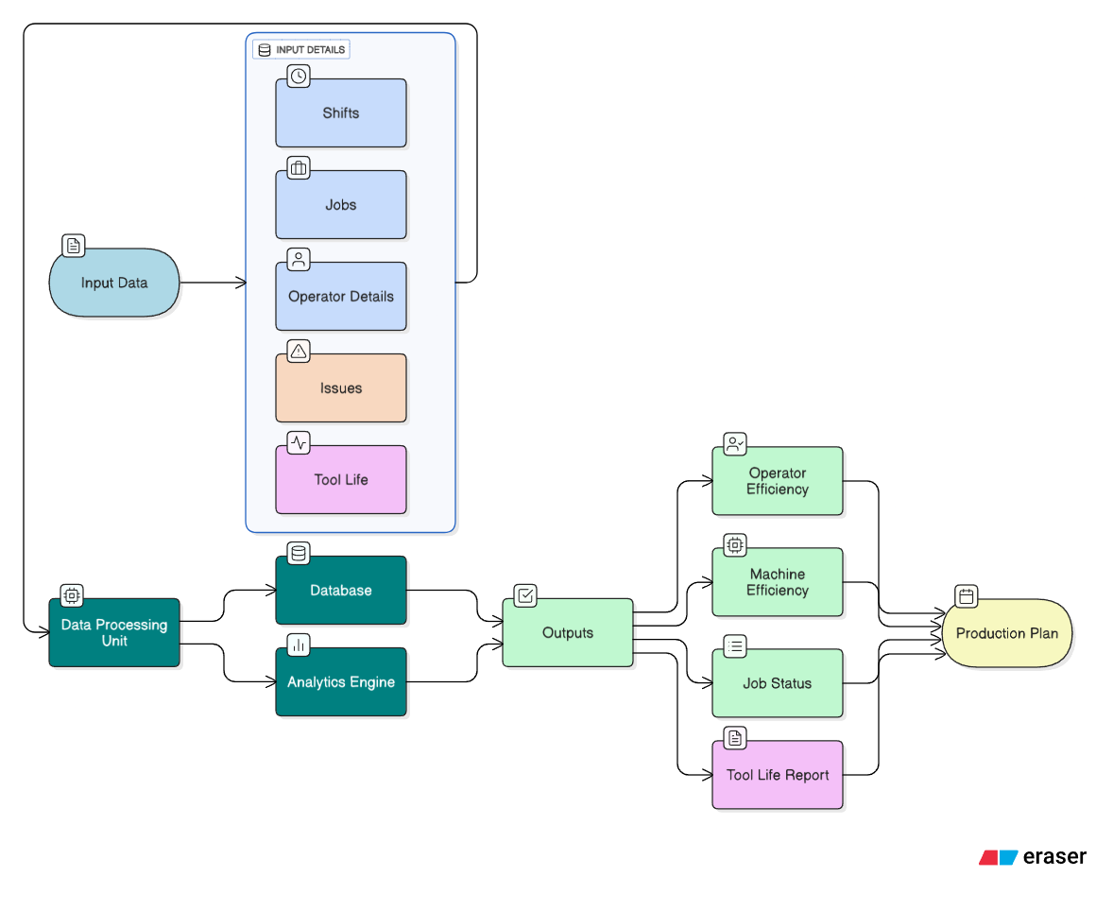
DEPARTMENT OF MECHANICAL ENGINEERING

Slide 9
Expected Results
Reduction in manual record-keeping
Real-time efficiency calculation (operator + machine)
Transparency in job tracking & downtime reporting
Improved production planning with live data
Tool life optimization, reducing tool cost and downtime
Enhanced productivity rate and income estimation for the owner
DEPARTMENT OF MECHANICAL ENGINEERING

Slide 10
Work Plan (Tentative)
Month 1: Requirement Analysis, Literature Survey, Finalize Proposal
Month 2: System Design, Tech Stack, UI/UX Wireframes
Month 3: App Frontend, Backend DB, Job Tracking (Alpha)
Month 4: Analytics Engine, Dashboard, Issue Reporting (Beta)
Month 5: Testing, Validation, Documentation, Final Demo
DEPARTMENT OF MECHANICAL ENGINEERING

Slide 11
References
Tulip Interfaces – Smart Manufacturing Apps. Available at: https://tulip.co
UpKeep – Maintenance Management Software. Available at: https://www.onupkeep.com
Prodsmart by Autodesk – Manufacturing Execution System (MES). Available at: https://www.autodesk.com/prodsmart
MaintainX – Work Order & Productivity Tracking. Available at: https://www.getmaintainx.com
Research articles on MES, Digital Productivity Monitoring, and Tool Life Management (IEEE, ScienceDirect, Springer).
DEPARTMENT OF MECHANICAL ENGINEERING

Slide 12
THANK YOU !
ANY QUESTIONS ?
DEPARTMENT OF MECHANICAL ENGINEERING

